Slide 1

CS 533 INTRO TO DATA SCIENCE
Michael Ekstrand

Slide 2
DATA

Slide 3

Learning Outcomes (week)
Locate data sources
Integrate data from multiple sources
Reason about bias and social effects of data
Photo by Aaron Burden on Unsplash

Slide 4



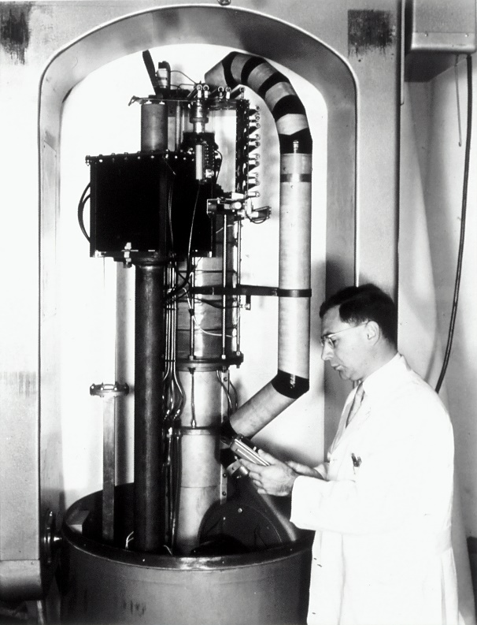

Sources of Data
Business records
Administrative records
Public service organizations
Physical observations
Surveys
Experiments (physical or social)
Online services / observations

Slide 5


Questions (from Week 2)
Who collected it?
Why?
How?
What does it contain?
What limitations does it have?
Pictures from dreamstime, located by @PACropDoc and @NoroNerd

Slide 6
Questions
How do we link it to other data?
Should we link it to other data?
How effective is the linkage?
What cleanup is needed to make it useful?
What ethical concerns govern its collection or use?
What biases might it contain?
We will never be exhaustive
Data is biased – question is how, and with what effect?

Slide 7
Things to Do
Get the raw data files
Transform data into usable format
Convert data types
Unify appropriate special codes (e.g. missing data)
Extract identifiers
Link with additional data sources
Extract the data set needed for your task

Slide 8



General Principles
Avoid Discarding Data
Measure Every Step
Look At Your Data

Slide 9
The Anna Karenina Principle of Data Science
Clean data sources are all alike; each messy data source is messy in its own way.

Slide 10

Wrapping Up
Data comes from a variety of sources.
We often need to compile multiple data sources to answer a question.
We need to question and document our data.
Photo by Giorgio Trovato on Unsplash

